Slide 1
CURRICULUM NIGHT
September 15, 2016

Slide 2
INTRODUCTIONS

Slide 3
AGENDA
Literacy
STEM
Assessment
Details
Q & A

Slide 4
LITERACY
Our North Star

Slide 5
COMMON CORE STATE STANDARDS
Reading Literature
Key Ideas and Details
Craft and Structure
Integrating Knowledge and Ideas
Speaking and Listening
Comprehension and Collaboration
Presentation of Knowledge and Ideas
Reading Informational Text
Key Ideas and Details
Craft and Structure
Integrating Knowledge and Ideas
Language
Conventions of Standard English
Vocabulary Acquisition and Use
Reading Foundational Skills
Phonics and Word Recognition
Fluency
Writing
Text Types and Purposes
Production and Distribution of Writing
Research to Build and Present Knowledge

Slide 6
READING LITERATURE & INFORMATIONAL TEXT
Ask Question
Answer Questions
Ask Questions
Answer Questions
Recount Stories
Determine Central Message
Identify Main Topic
Make Connections
Identify Character Changes
Use Text Features
Identify Story Structure
Determine Perspective

Slide 7
READING FOUNDATIONAL SKILLS & LANGUAGE
Decoding
Word Structure
Word Recognition
Spelling
Prosody
Parts of Speech

Slide 8
WRITING
Narrative
Informative
Persuasive

Slide 9
STEM
STEM LAB AND
TECHNOLOGY LAB

Slide 10
COMPONENTS OF STEM
Science
Technology
Engineering
Mathematics

Slide 11
MATHEMATICS
Number & Operations in Base Ten
Geometry
Operations and Algebraic Thinking
Measurement and Data

Slide 12
MAJOR CONCEPTS
Hundreds, Tens, Ones
Composition & Decomposition
Types of Word Problems
Addition and Subtraction Word Problems
Length
Money

Slide 13
TECHNOLOGY AND ENGINEERING
Science Lab
Technology Class
Classroom Technology Integration

Slide 14
SCIENCE
Force & Motion
Matter: Properties and Change
Earth Systems, Structures, and Processes
Structures and Functions of Living Organisms
Evolution and Genetics

Slide 15
SOCIAL STUDIES
History
Geography and Environmental Literacy
Economics and Financial Literacy
Civics and Government
Culture

Slide 16
ASSESSMENTS

Slide 17
FORMS OF ASSESSMENT
Literacy
Math
TRC
Kathy Richardson
DIBELS
MAP
MAP
Common Assessments will be given in all subjects.

Slide 18
DETAILS

Slide 19
SCHEDULE
We run on a 6 day schedule
8:15-8:45 Arrival, unpack, morning work
8:45-8:50 Announcements
8:50-9:30 Encore
9:30-10:15 Special Area
10:15-10:35 Words Their Way
10:39-11:04 Lunch
11:10-11:30 Read Aloud
11:30-12:35 Readers Workshop
12:35-1:05 Writers Work Shop
1:05- 1:35 Recess
1:35-3:05 Math Workshop 3:05-3:40 Science/Social Studies
3:45 Afternoon announcements/ Dismissal
*Start/End Time
*Snack Time
*Water Bottle

Slide 20
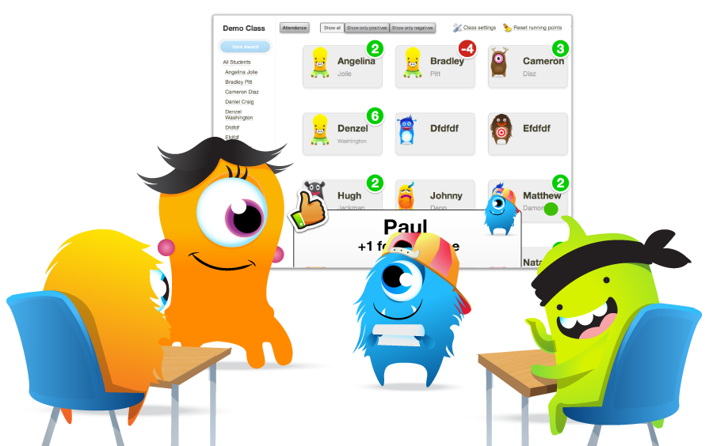
Class Dojo

Slide 21
SCHOOL TO HOME PROCEDURES
Planners
Please sign nightly.
Homework Folders
Please check nightly.
Thursday Folders

Slide 22
HOMEWORK
Nightly Reading Log
Math Packet or Choice Board

Slide 23
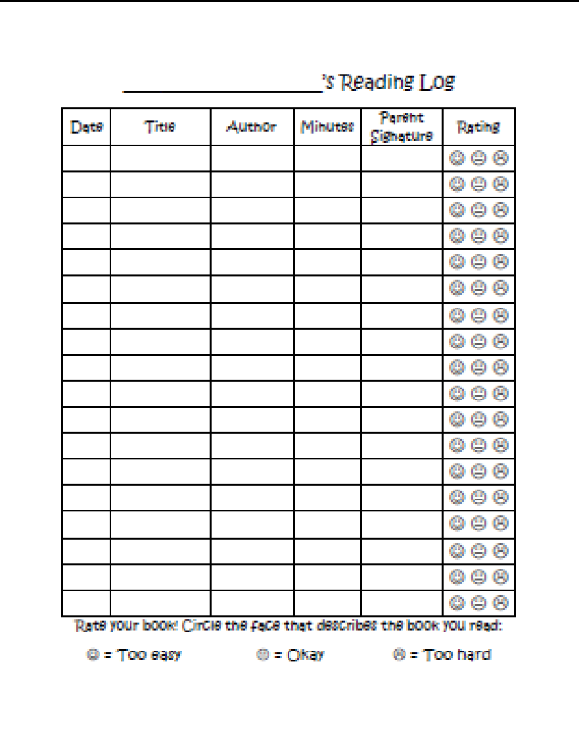
Reading and Math
2nd Grade Math Homework Choice Board You must complete at least six activities from this board
Coin Values John has 3 dimes, 4 nickels, and 2 pennies. He wants to buy an eraser that costs 50 cents. Does he have enough money? How do you know? | Combinations Show 8 ways to make 10 using two numbers. _____ + _____ | Story Problems Sam has 17 stickers. If his sister gives him 12 more, how many stickers will he have?
Coin Values Jamie has 5 dimes, 3 nickels, and 9 pennies. He wants to buy a popsicle that costs 65 cents. Does he have enough money? How do you know? | Story Problems Make up your own story problem using double digit numbers. | Coin Combinations Show four different combinations of coins that make 59 cents.
Combinations Show 8 ways to make 10 using three numbers. ___ + ___ + ___ | Story Problems Taylor has 22 cubes for her math project. She takes 25 more. How many cubes does she have now? | Today’s Number Show at least five different ways that you can make the number 26.

Slide 24
GRADING
3: Consistently Meets Grade Level Expectations
2: Inconsistently Meets Grade Level Expectations
1: Does Not Yet Meet Grade Level Expectations

Slide 25
COMMUNICATION
Website
Newsletter
Email
Telephone
Planner Notes

Slide 26
QUESTIONS AND ANSWERS

Slide 27
THANK YOU!

